Slide 1




Project Title: Internship Management Portal for Students
Project Advisor: Dr. Mukesh Kumar
Submitted by:
Atul Kumar 12102801
Abhinav Kumar 12102850
School of Computer Applications
Lovely Professional University, Punjab

Slide 2
Agenda
Brief overview
Statement of the problem
Proposed system
Overview
Tools & Technology
User Interface

Slide 3
Overview
With the advancement in the technology, in the world people are trying to get things on the desk without wasting anytime as nowadays time is the most important thing in the world. Because of technology people are trying to get knowledge of their jobs as well. Organizations also have to advertise about the jobs in newspapers and television which is time consuming .

Slide 4
Problem Statement
It is not possible for every job seeker to view the newspaper daily and the result is many of the people are become unaware of the jobs. People have to visit different places for the jobs which is much time consuming and costly.

Slide 5
Introduction
In this portal different organizations, institutions etc. display/ advertise jobs according to their requirements so that the people or job seekers view the different kind of jobs and the further information about the related organization. Organizations also check the CV’s of job seekers if he/she fulfill the requirements of the organizations, they hire or contact them for the jobs.

Slide 6
Purpose
The purpose of designing an internship management portal is to give the internship for job seekers a platform for finding a right and a satisfactory internship according to their qualification. It also connects the job seekers with the major organizations.

Slide 7
Scope
The scope of the internship management portal includes :
Internship Management Portal System that is to be developed provides the members with internship information, online applying for jobs and many other facilities. The basic scope of the project is given as under.
Employee/ Job seekers
Employee/ Job provider
Admin of site
Admin of company

Slide 8
Main Module
Employee /Job seekers
Employer/ Job providers
Admin of site
Admin of company

Slide 9
Tools & Technology
Php
MySql
HTML
CSS
Java script
Visual Studio
Xampp server
Bootstrap

Slide 10
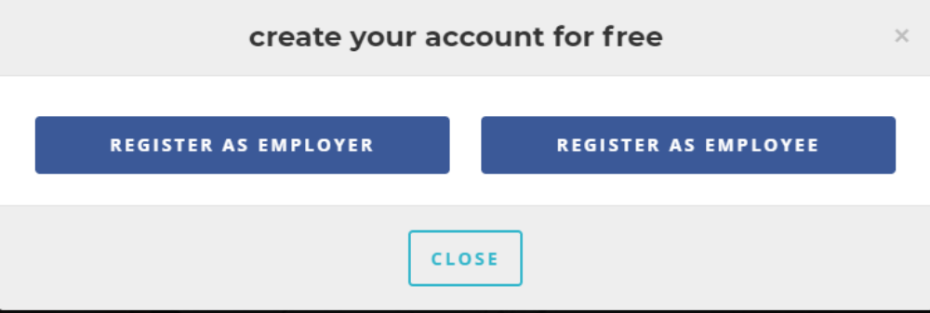
User Register Page:

Slide 11
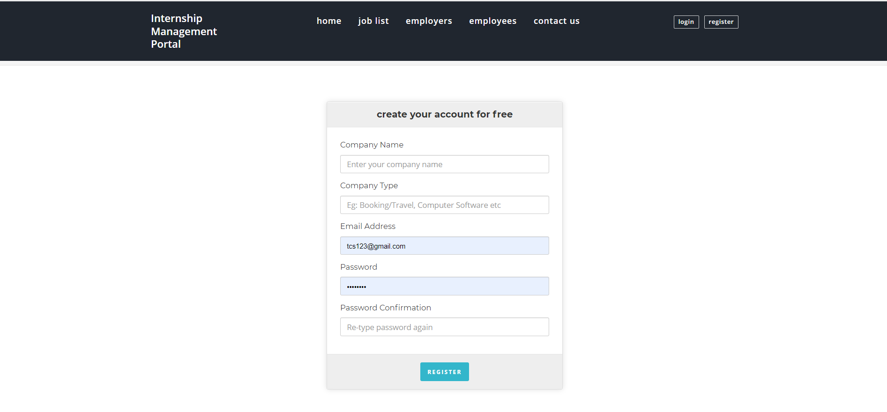
Employer Register Page:

Slide 12
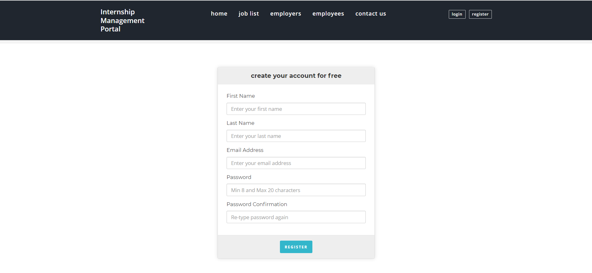
Employees Register Page:

Slide 13
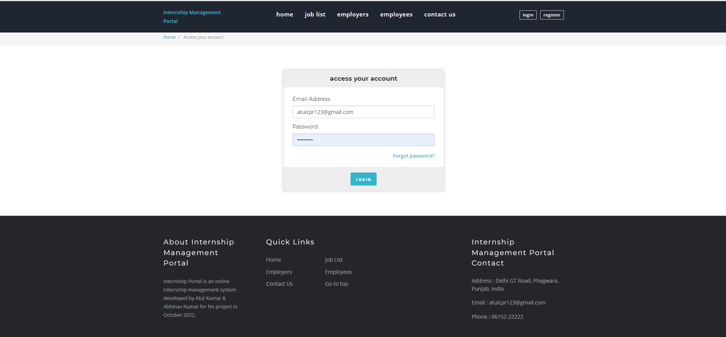
Login Page:

Slide 14

Home Page:

Slide 15
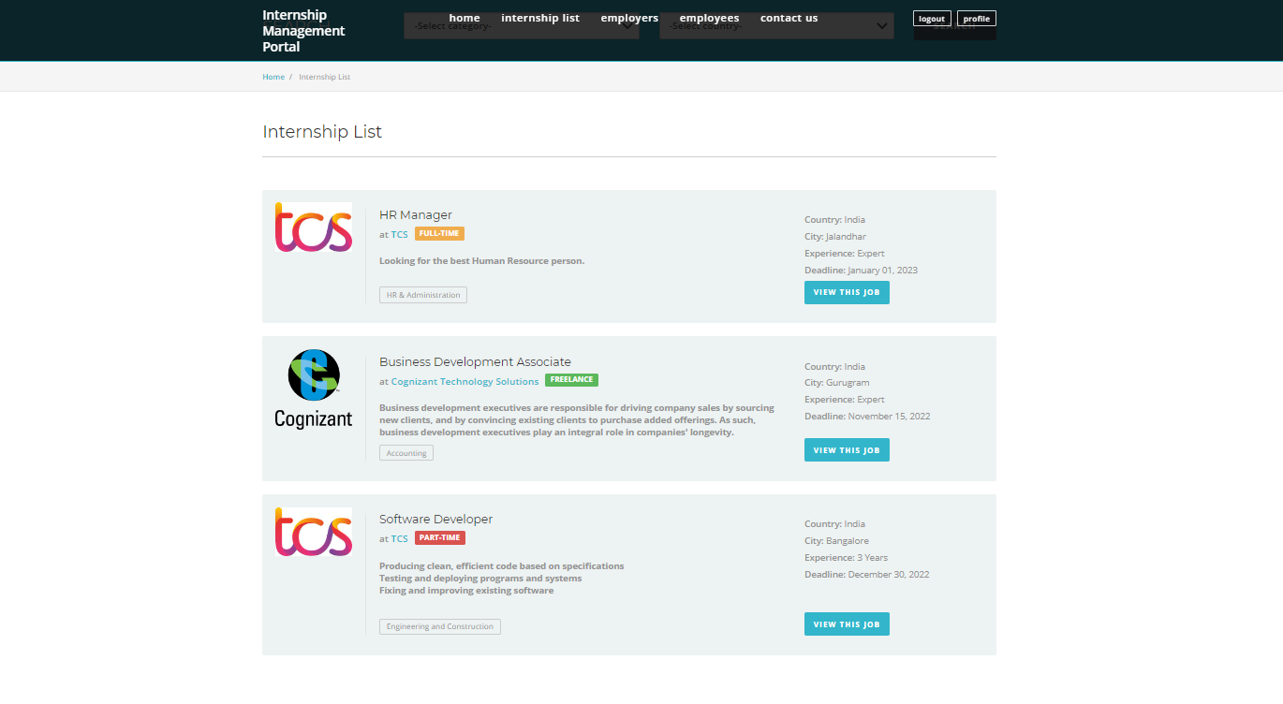
Internship Search Page:

Slide 16
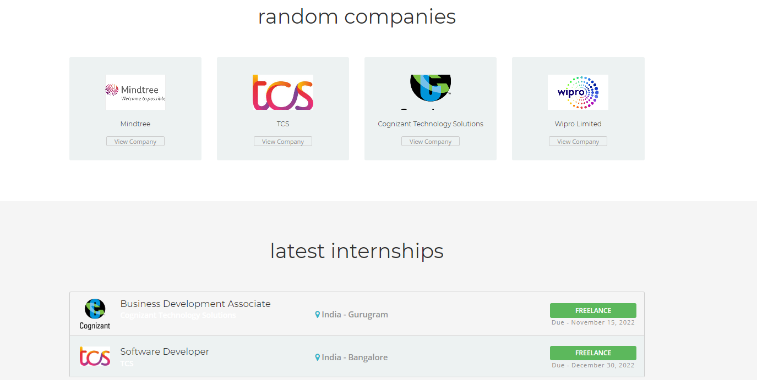
Employers Page:

Slide 17
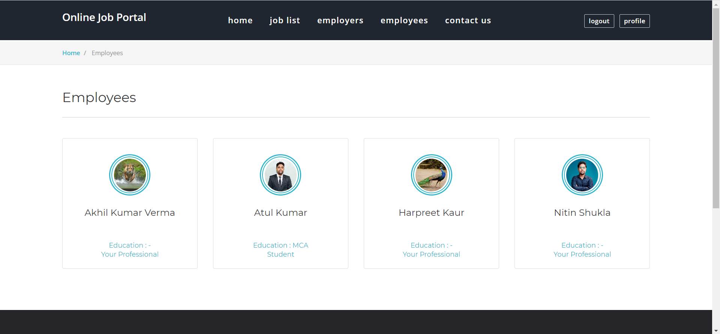
Employees Page:

Slide 18
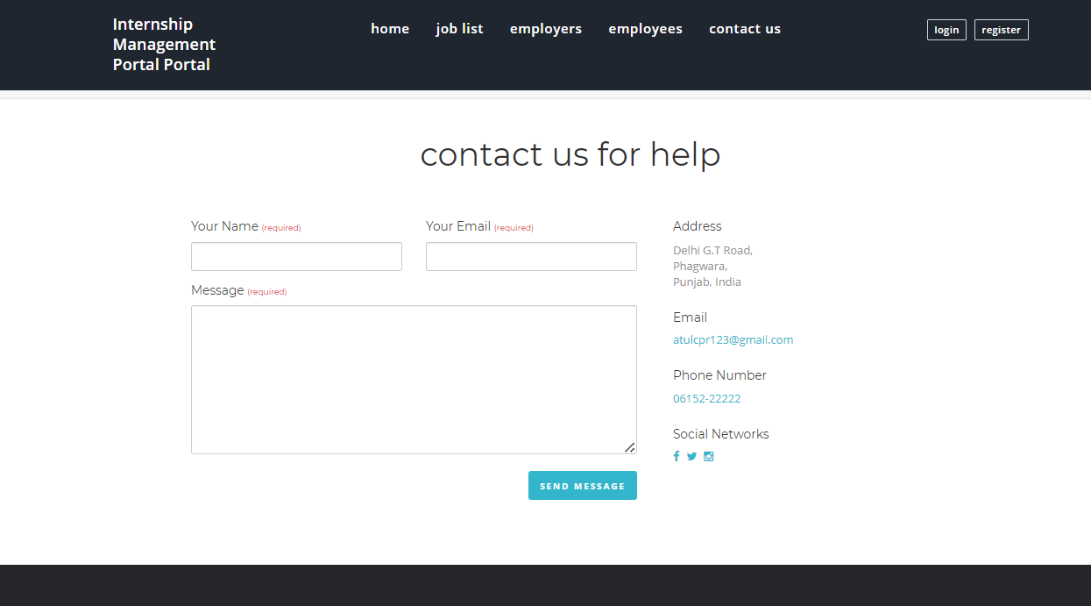
Contact Us Page:

Slide 19
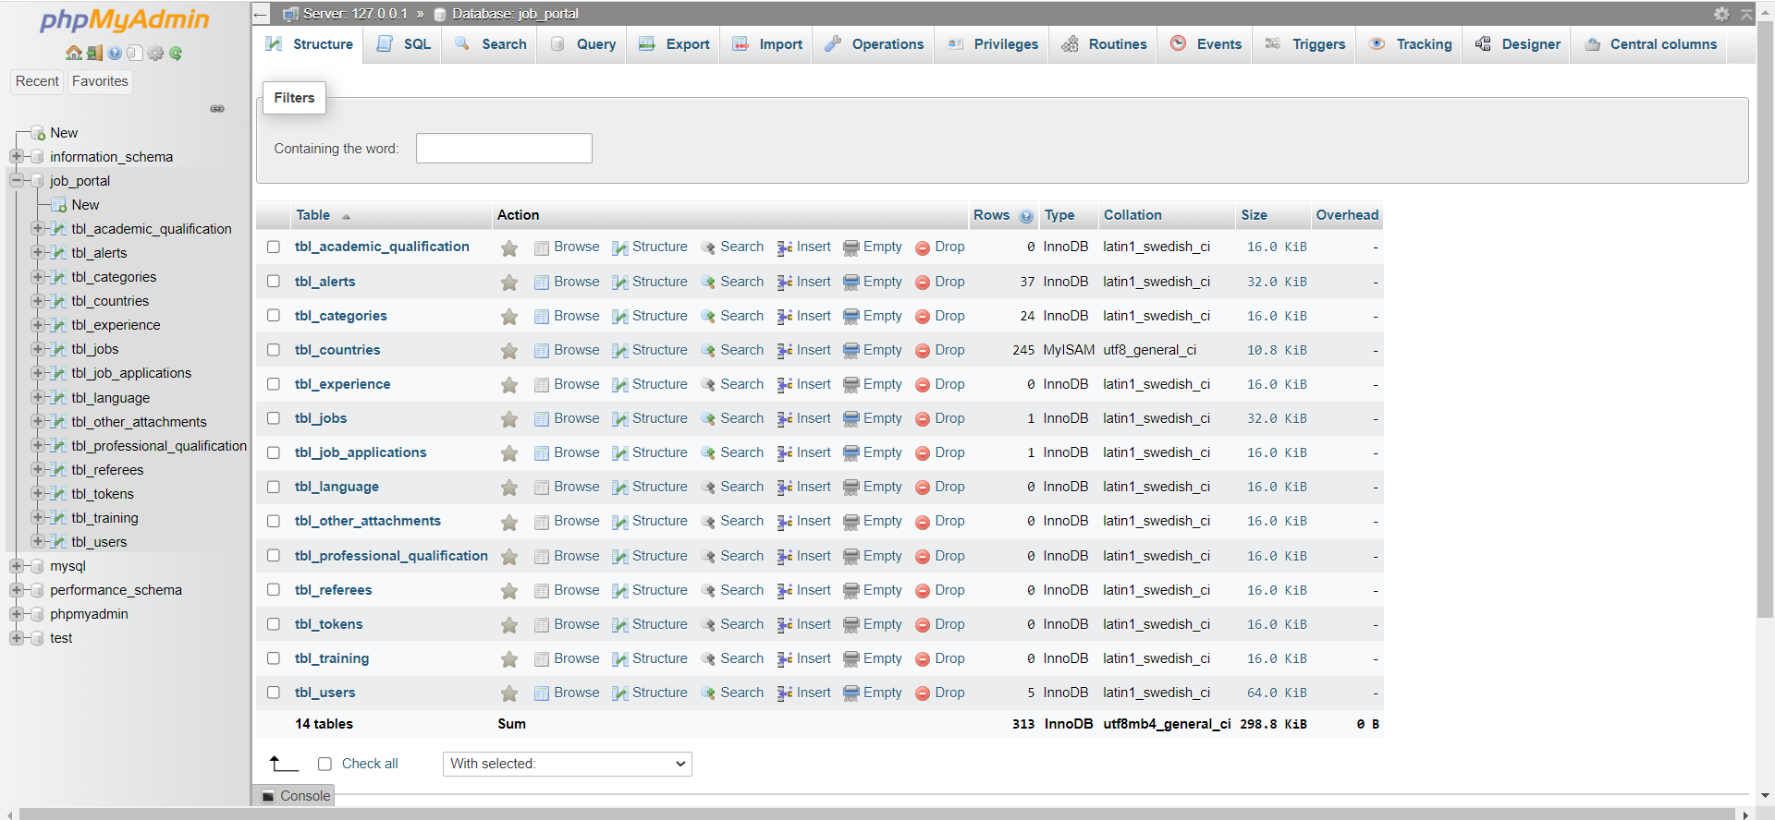
Database

Slide 20



